Slide 1

QUOTES OF FAMOUS PEOPLE

Slide 2

“Don't cry because it's over, smile …”

Slide 3
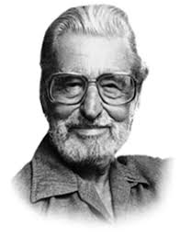
“Don't cry because it's over, smile because it happened.”
Dr. Seuss (an American author, political
cartoonist, best known for authoring more
than 60 children’s books)

Slide 4
“You only live once, but …”

Slide 5
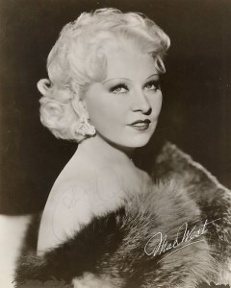
You only live once, but
if you do it right,
once is enough.”
Mae West (an American
actress and screenwriter )

Slide 6
“In three words I can sum up everything I've learned about life: ...”

Slide 7
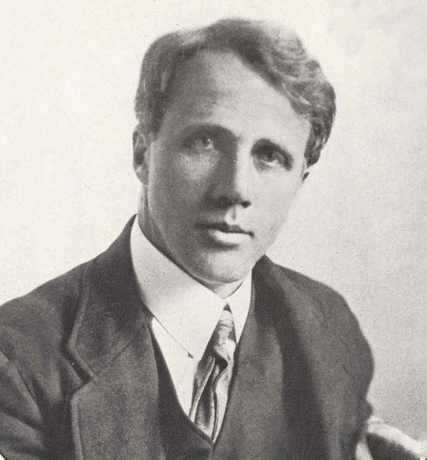
“In three words I can sum up everything I've learned about life: it goes on.”
Robert Frost (an American poet)

Slide 8
“If you tell the truth, you don't have to ...”

Slide 9
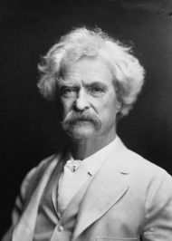
“If you tell the truth, you don't have to remember anything.”
Mark Twain
(an American writer)

Slide 10
“You know you're in love when you can't fall asleep because ...”

Slide 11
“You know you're in love when you can't fall asleep because reality is finally better than your
dreams.”
Dr. Seuss (an American author, political
cartoonist, best known for authoring more
than 60 children’s books)

Slide 12
“To live is the rarest thing in the world. Most people …”

Slide 13
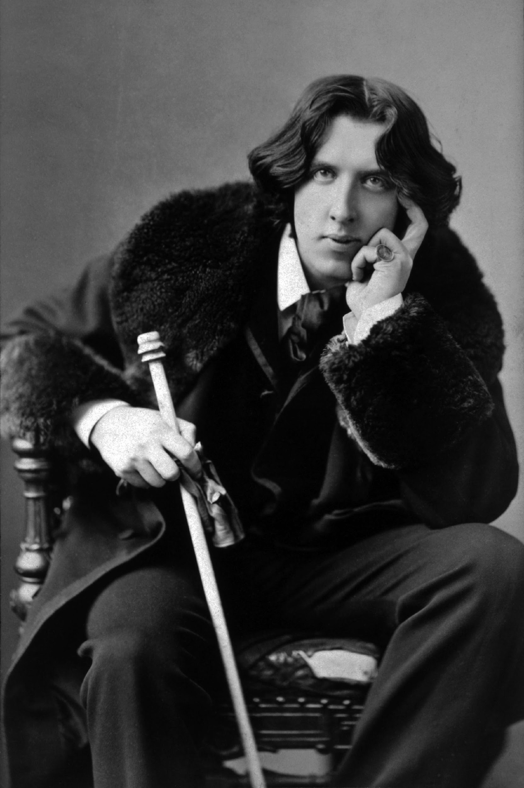
“To live is the rarest thing in the world. Most people exist,
that is all.”
Oscar Wilde
(Irish poet and playwright)

Slide 14
“For every minute you are angry you ...”

Slide 15
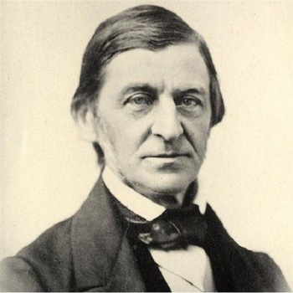
“For every minute you are angry you lose sixty seconds of happiness.”
Ralph Walso Emerson
(American lecturer and
philosopher)

Slide 16
“Everyone thinks of changing the world, but no one thinks of ...”

Slide 17
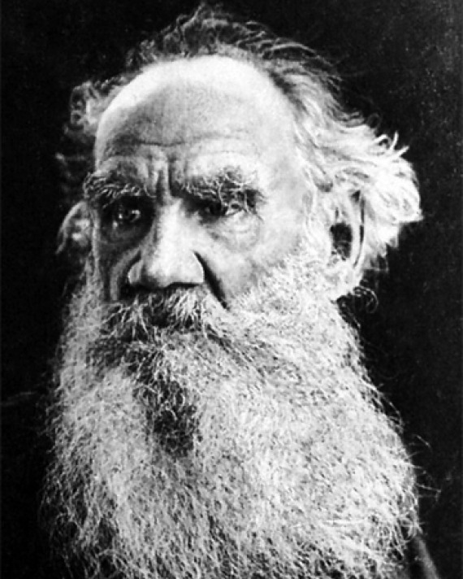
“Everyone thinks of changing the world, but no one thinks of changing himself.”
Leo Tolstoy
(Russian writer who is regarded
as one of the greatest authors of all times)

Slide 18
“Happiness is not something ready made. It comes ...”

Slide 19
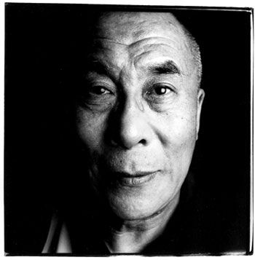
“Happiness is not something ready made. It comes from your
own actions.”
Dalai Lama
(spiritual leader of the Tibetan people)

Slide 20
“I find television very educating. Every time somebody turns on the set...”

Slide 21
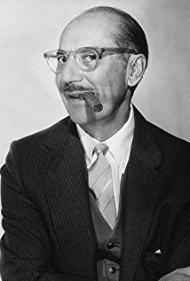
“I find television very educating. Every time somebody turns on the set,
I go into the other room and read a book.”
Groucho Marx
(American comedian, writer,
known as a master of quick wit)

