Slide 1
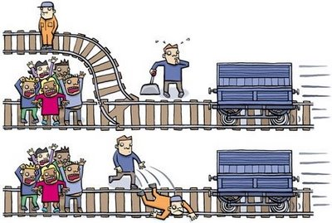
LIFELONG MORAL DILEMAS

Slide 2
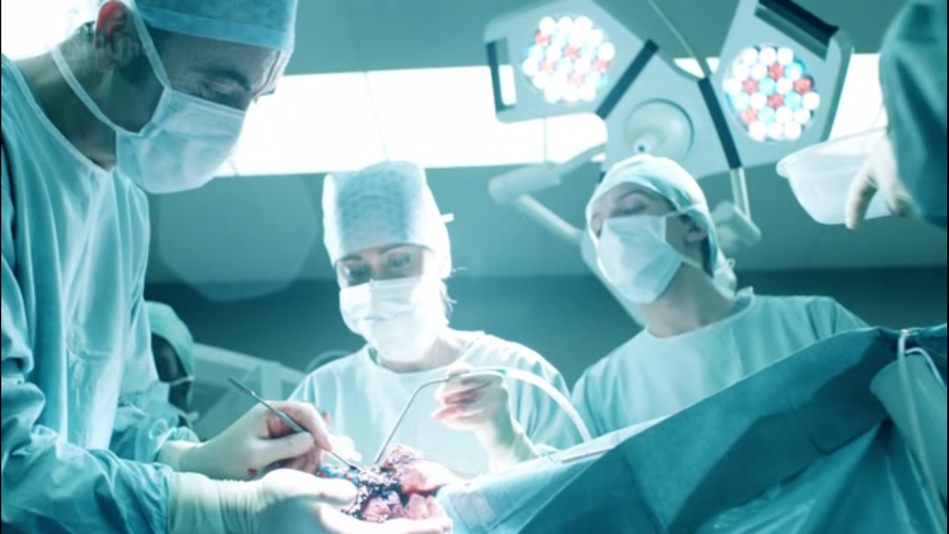
You are a very skilled doctor with five dying patients, each of whom needs a different organ in order to live. Unfortunately, there are no organs available to perform any of the transplants. It just so happens that you have a sixth dying patient, suffering from a fatal illness, who will die sooner than the other five if not treated. If this sixth patient dies, you will be able to use his organs to save the five other patients. However, you have a medicine you can give to this sixth patient that will cure his illness and he won’t die. Would you: a: Wait for the patient to die and then harvest his organs or b: Save the patient even though the other patients won’t get organs.

Slide 3
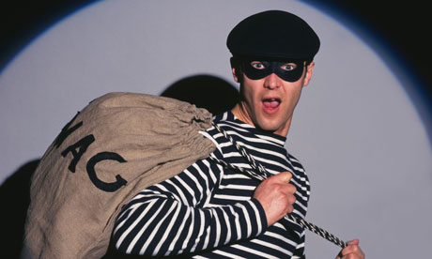
You have witnessed a man rob a bank, but then, he did something completely unusual and unexpected with the money. He donated it to an orphanage that was poor, run-down and lacking in proper food, care, water and amenities. The sum of money would be a great benefit to the orphanage, and the children’s lives would turn from poor to prosperous. Would you: a: Call the police and report the robber, even though they would likely take the money away from the orphanage, or b: Do nothing and leave the robber and the orphans alone?

Slide 4
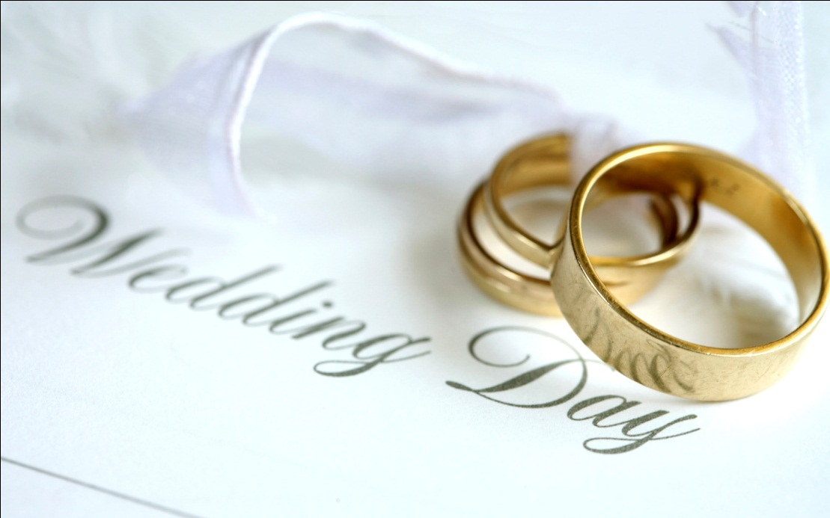
Your best friend is about to get married. The ceremony will be performed in one hour, but you have seen, just before coming to the wedding, that your friend’s fiancee has been having an affair. If your friend marries this woman, she is unlikely to be faithful, but on the other hand, if you tell your friend about the affair, you will ruin his wedding. Would you, or would you not, tell your friend of the affair?

Slide 5
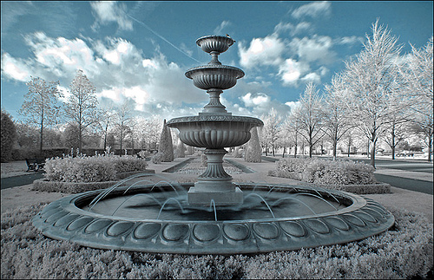
A man/woman, is immortal, because he and his/her family have drank from a fountain of youth, not knowing what it was. You are now in love with this person and have felt this way long enough that you know (s)he to be your destiny. However, the only way you can stay together forever is if you drink from the fountain of youth and become immortal, too. If you do this, however, your family and everyone else you know will grow old and eventually die, and you will never be reunited in heaven with them, or your loved ones that you have known, who have already died. On the other hand, if you don’t drink from the fountain, you will grow old and eventually die, and the person with whom you are in love will never see you again, and be condemned to an eternity of loneliness and only memories of you. What would you do?

Slide 6
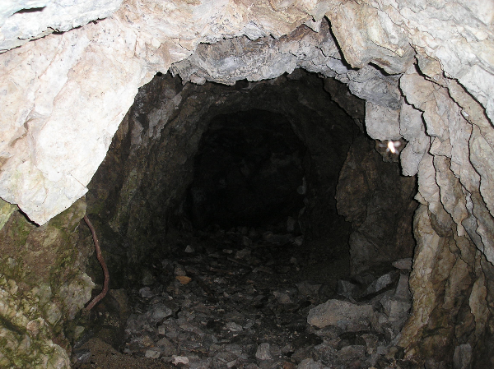
Heather is part of a four-person mining expedition. There is a cave-in and the four of them are trapped in the mine. A rock has crushed the legs of one of her crew members and he will die without medical attention. She’s established radio contact with the rescue team and learned it will be 36 hours before the first drill can reach the space she is trapped in.
She is able to calculate that this space has just enough oxygen for three people to survive for 36 hours, but definitely not enough for four people. The only way to save the other crew members is to refuse medical aid to the injured crew member.
Should Heather allow the injured crew member to die in order to save the lives of the remaining crew members?

