Slide 1
APPEARANCE

Slide 2
HAIR:

Slide 3
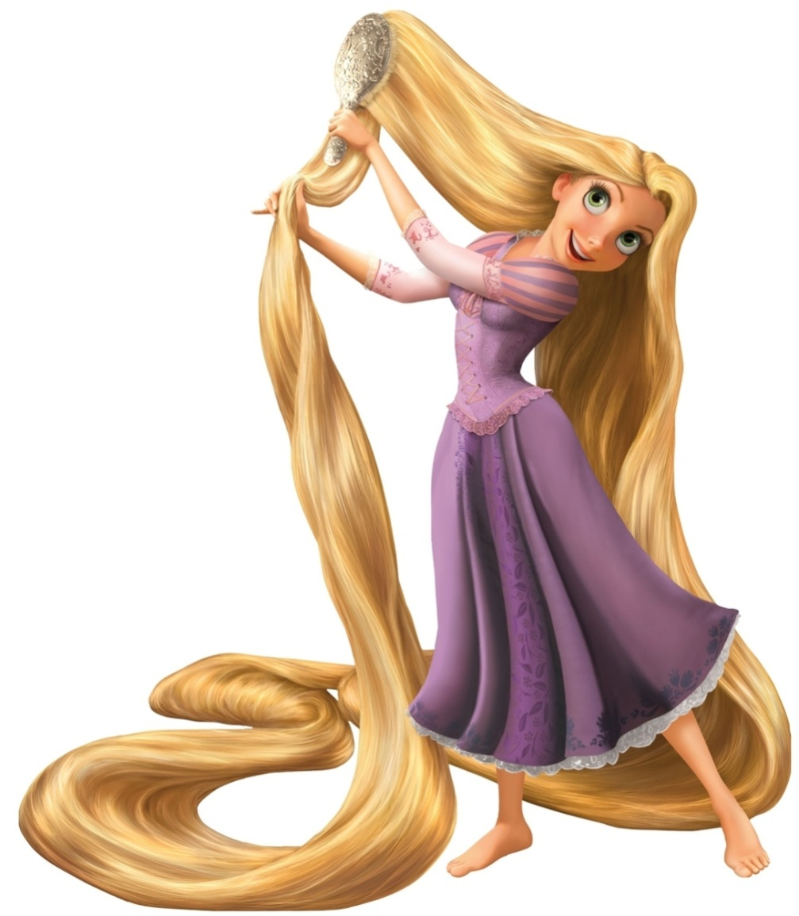


Slide 4
long hair

Slide 5
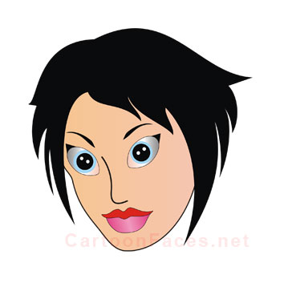

Slide 6
short hair

Slide 7
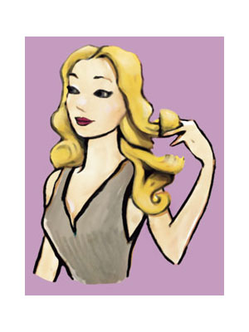

Slide 8
wavy hair

Slide 9
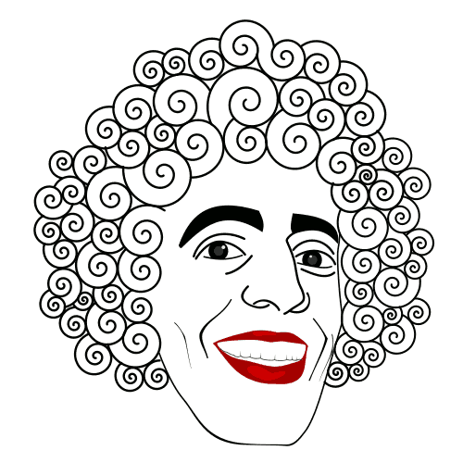

Slide 10
curly hair

Slide 11
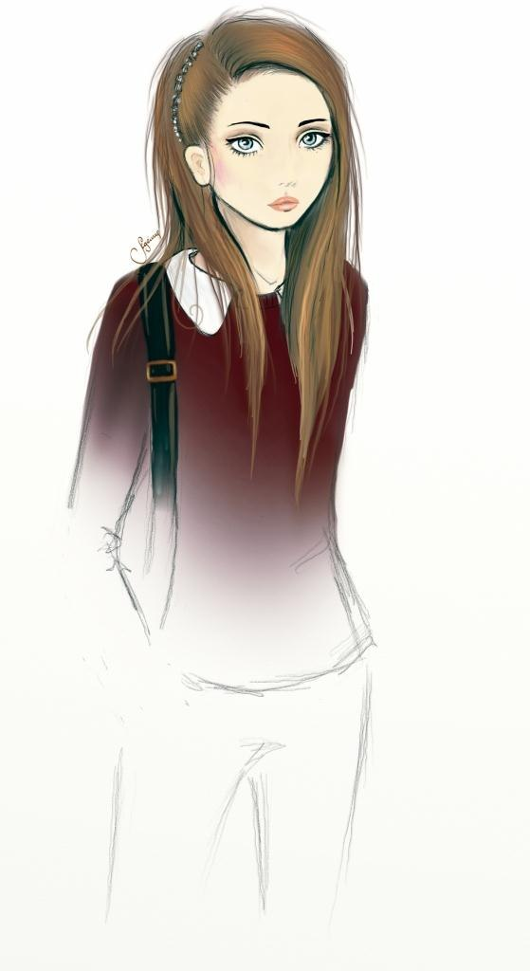

Slide 12
straight hair

Slide 13
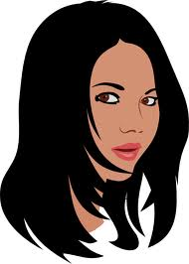

Slide 14
black hair

Slide 15
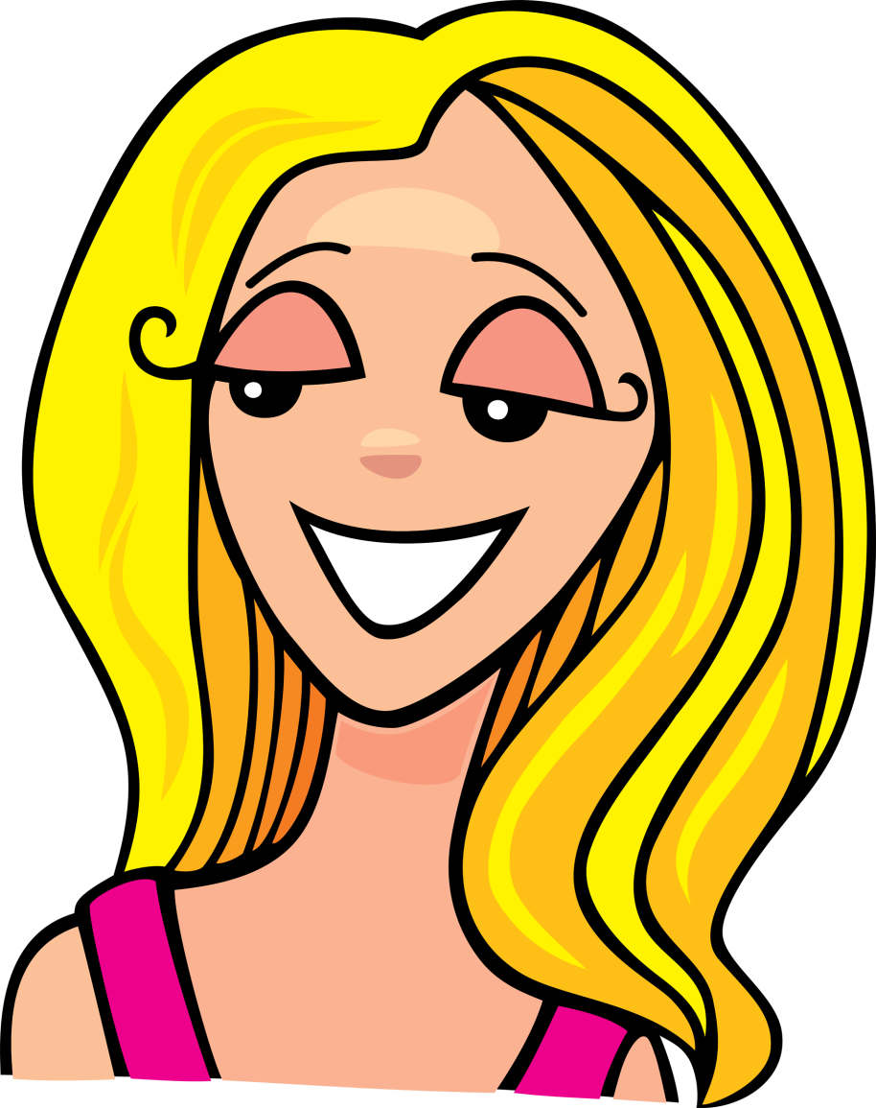

Slide 16
blonde fair hair

Slide 17
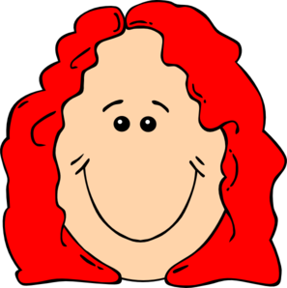

Slide 18
to be red-haired to be ginger-haired

Slide 19
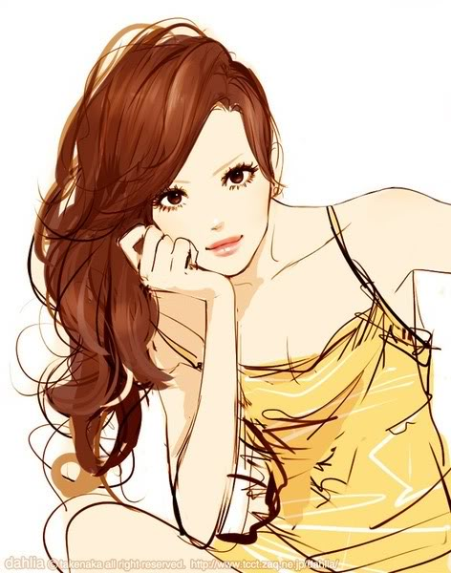

Slide 20
auburn hair red-brown hair

Slide 21
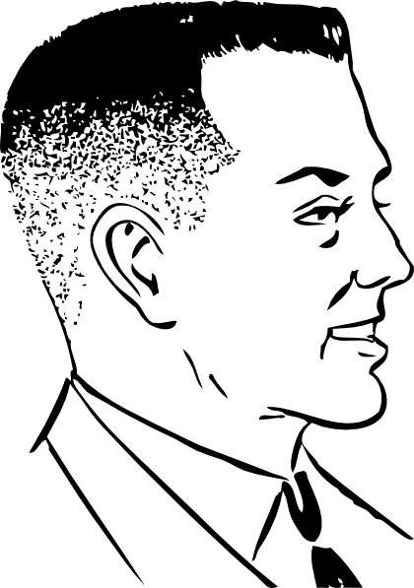

Slide 22
crew-cut

Slide 23
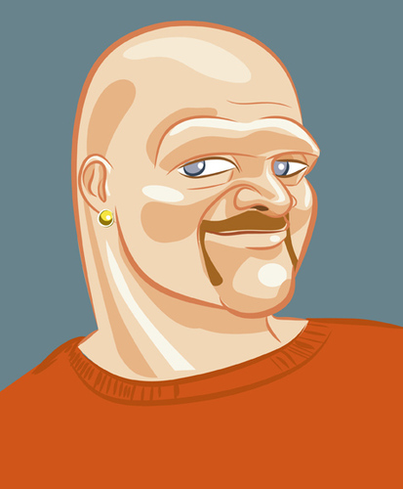

Slide 24
bald

Slide 25
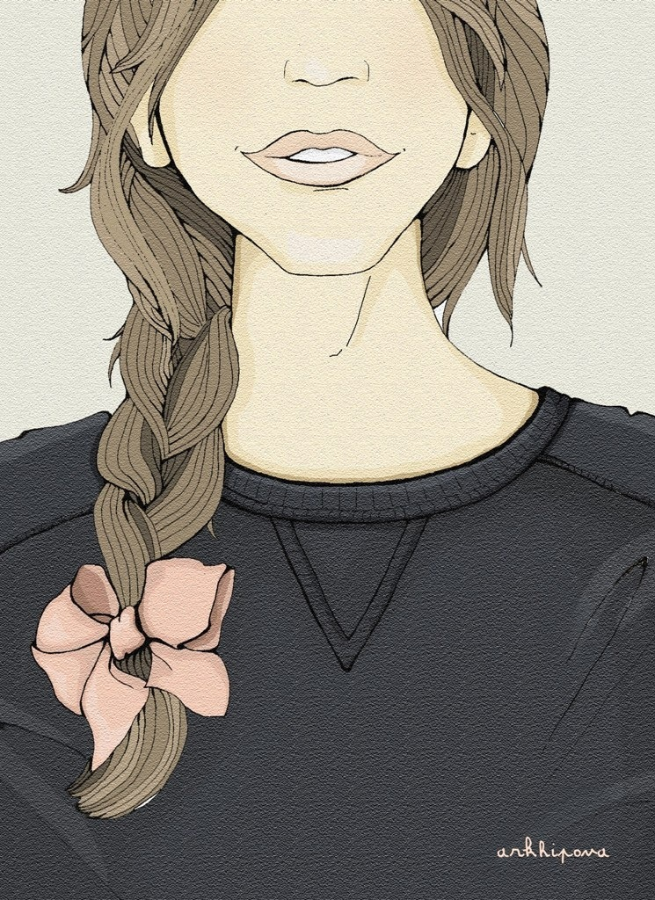

Slide 26
braid

Slide 27
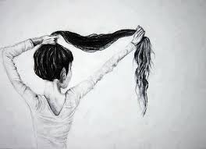

Slide 28
ponytail

Slide 29
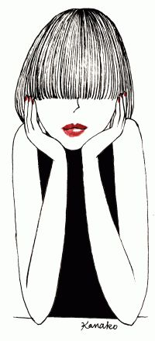

Slide 30
fringe

Slide 31
GENERAL APPEARANCE
HEIGHT AND BUILT:

Slide 32
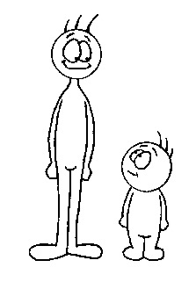

Slide 33
tall short

Slide 34
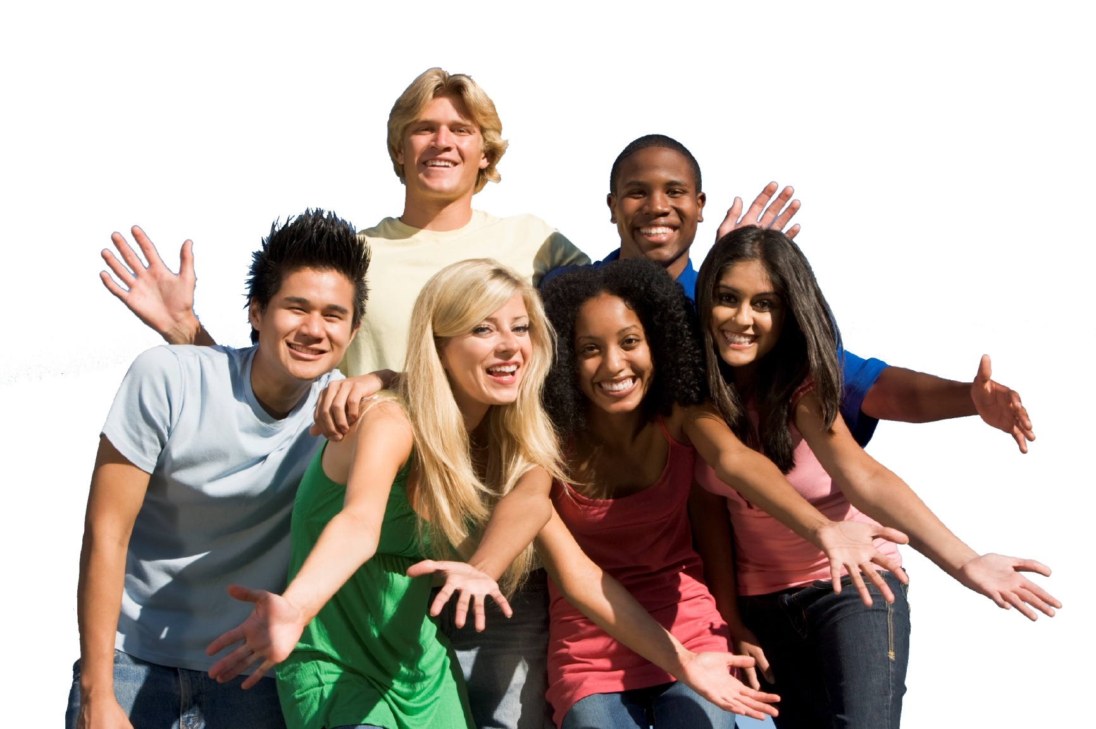

Slide 35
young

Slide 36
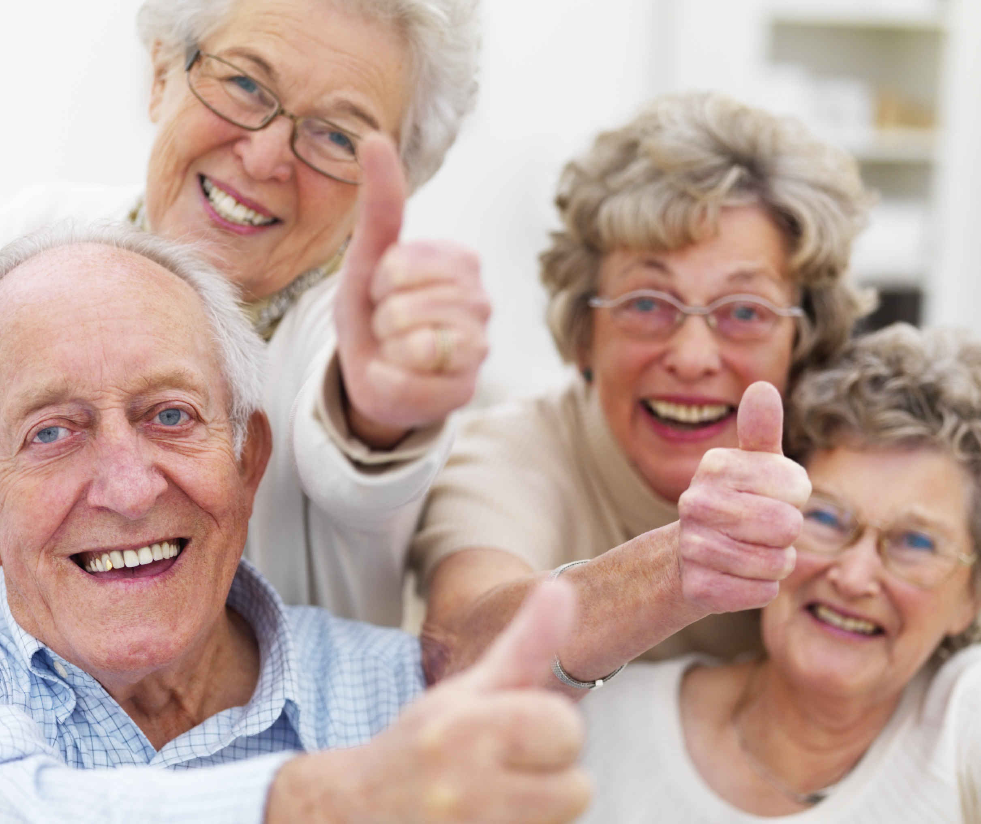

Slide 37
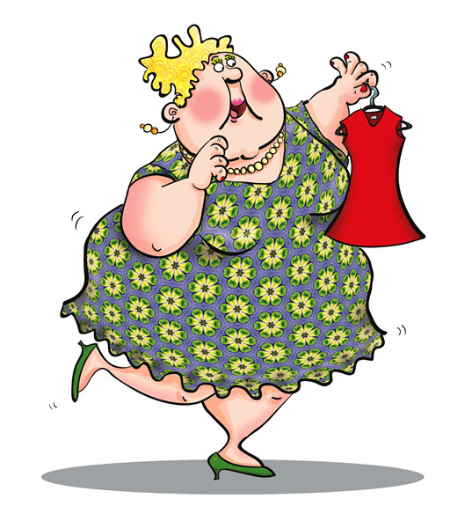

Slide 38
over-weight obese / fat (negative)

Slide 39
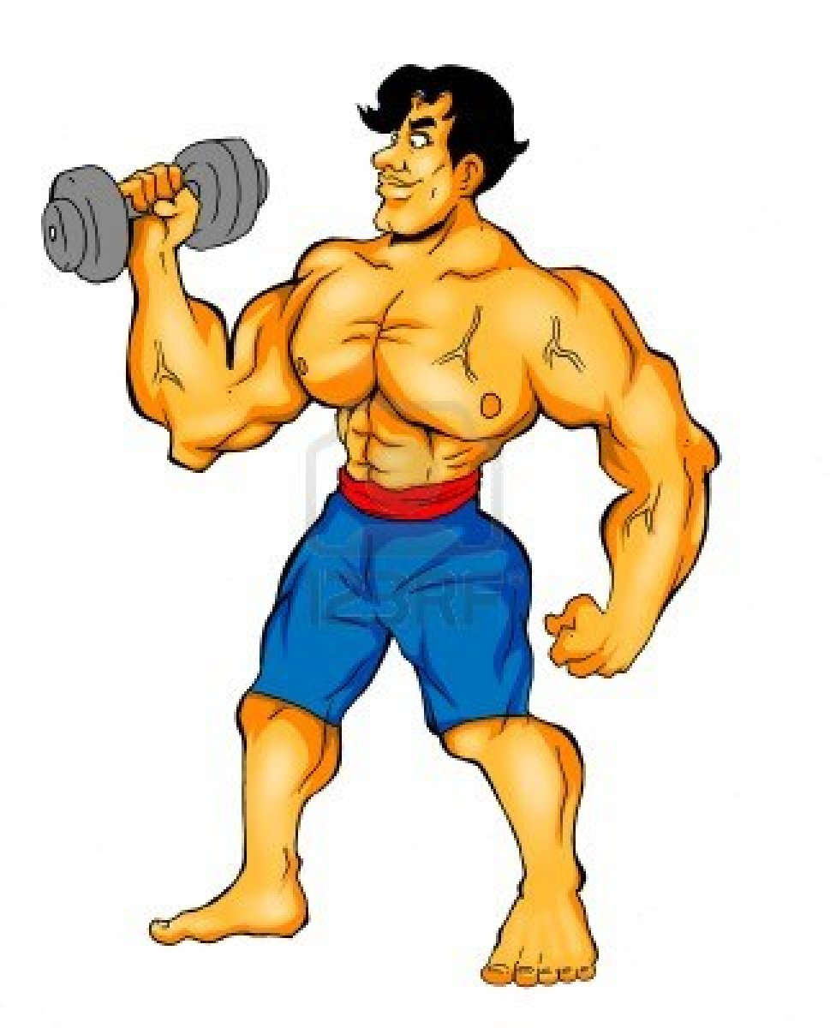

Slide 40
muscular athletic

Slide 41
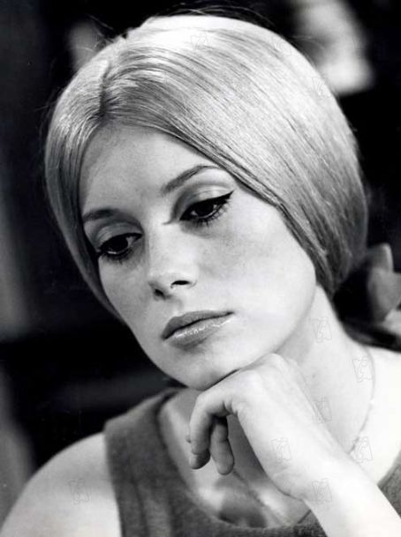

Slide 42
beautiful/ gorgeous/ pretty

Slide 43
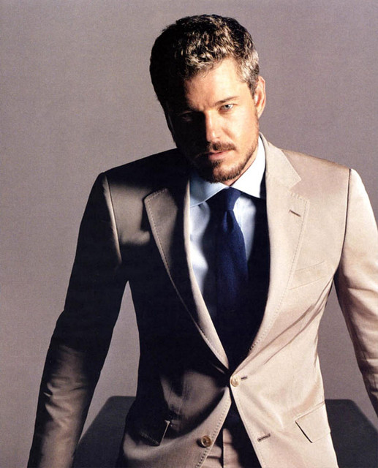

Slide 44
handsome

Slide 45
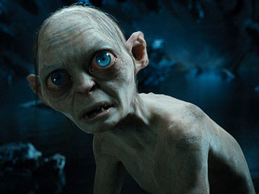

Slide 46
ugly

Slide 47
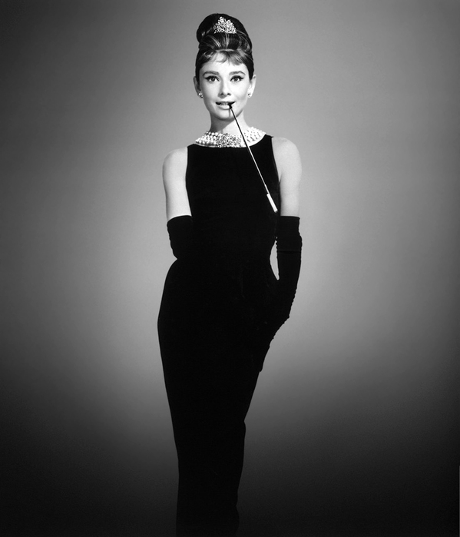

Slide 48
elegant / well-dressed good-looking

Slide 49
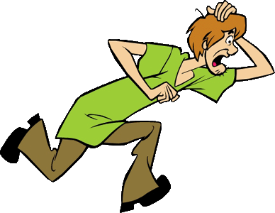

Slide 50
untidy-looking/ scruffy/ shabby

Slide 51
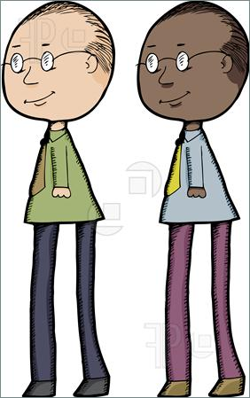

Slide 52
to be dark-skinned to be fair-skinned

Slide 53
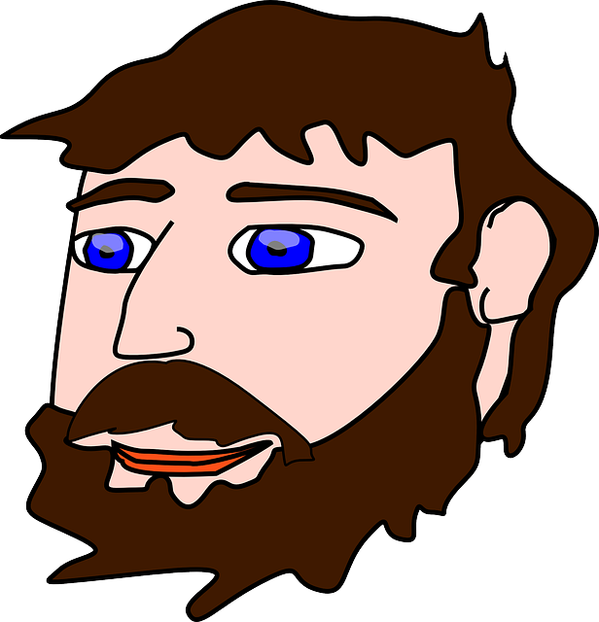

Slide 54
beard

Slide 55
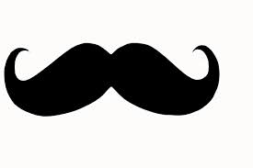

Slide 56
moustache

Slide 57
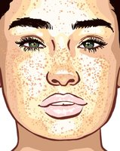

Slide 58
freckles

Slide 59
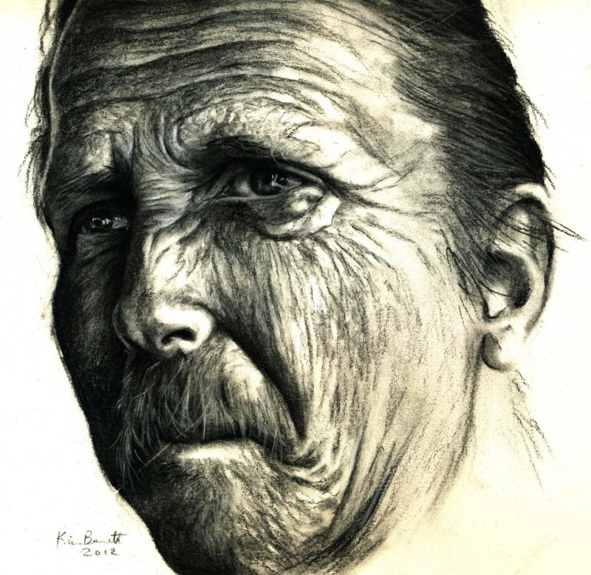

Slide 60
wrinkles

Slide 61
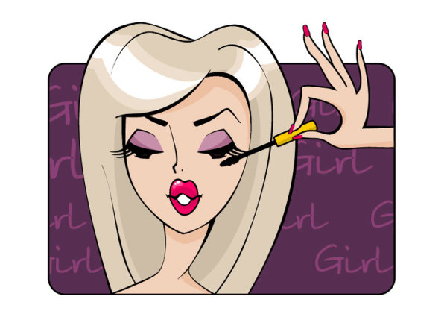

Slide 62
to do make-up

Slide 63
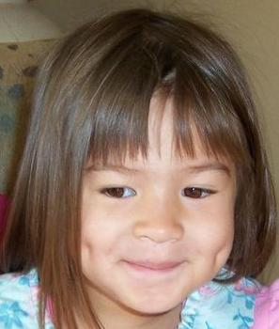

Slide 64
dimples

Slide 65
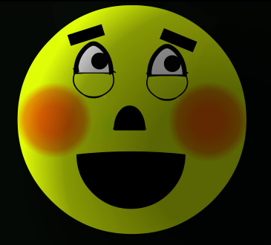

Slide 66
blush

