Slide 1
CONTAINERS AND CONTENTS

Slide 2
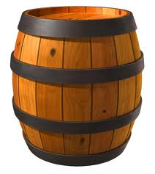

Slide 3
barrel

Slide 4
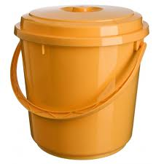

Slide 5
bucket

Slide 6
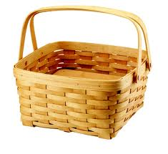

Slide 7
basket

Slide 8
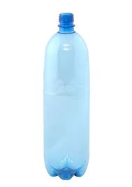

Slide 9
bottle

Slide 10
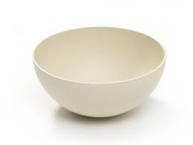

Slide 11
bowl

Slide 12
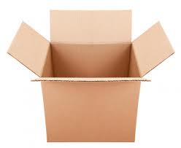

Slide 13
box

Slide 14
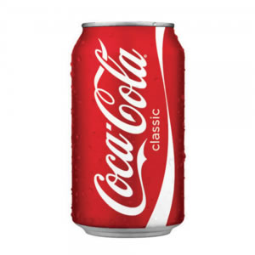

Slide 15
can

Slide 16
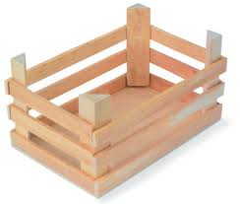

Slide 17
crate

Slide 18
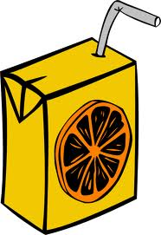

Slide 19
carton

Slide 20
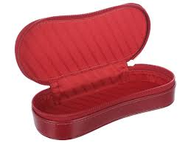

Slide 21
case

Slide 22
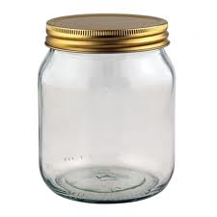

Slide 23
jar

Slide 24
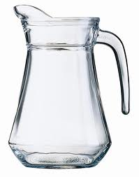

Slide 25
jug

Slide 26
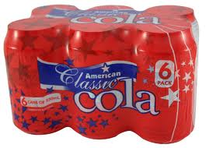

Slide 27
pack

Slide 28
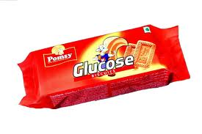

Slide 29
packet

Slide 30
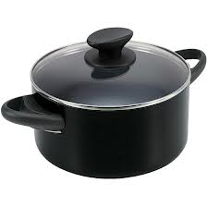

Slide 31
pan

Slide 32
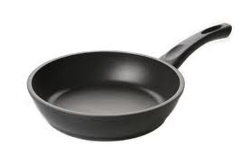

Slide 33
frying pan

Slide 34
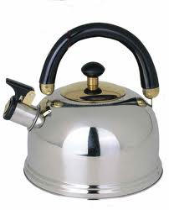

Slide 35
kettle

Slide 36
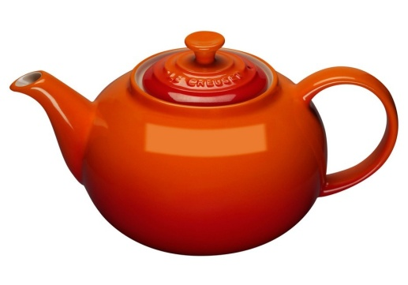

Slide 37
tea pot

Slide 38
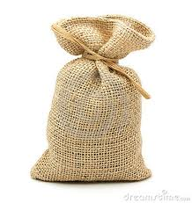

Slide 39
sack

Slide 40
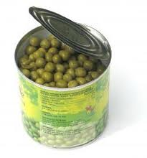

Slide 41
tin

Slide 42
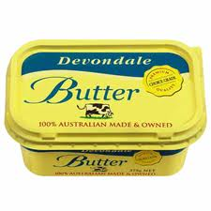

Slide 43
tub

Slide 44
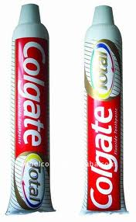

Slide 45
tube

Slide 46
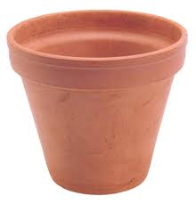

Slide 47
flower pot

Slide 48
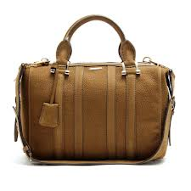

Slide 49
bag

Slide 50
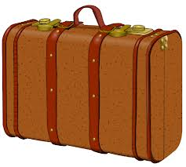

Slide 51
suitcase

Slide 52
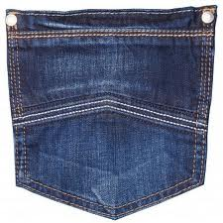

Slide 53
pocket

Slide 54
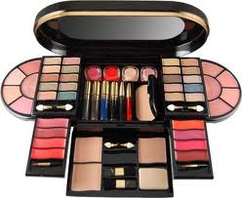

Slide 55
make-up kit

Slide 56
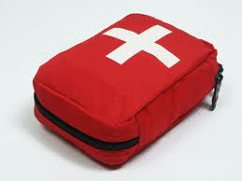

Slide 57
first-aid kit

Slide 58
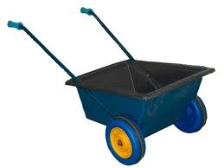

Slide 59
cart

Slide 60
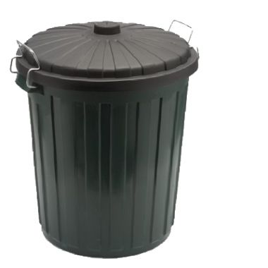

Slide 61
rubish bin

