Slide 1
PARTS OF THE BODY

Slide 2
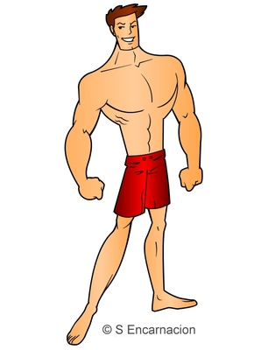


Slide 3
body

Slide 4


Slide 5
face

Slide 6
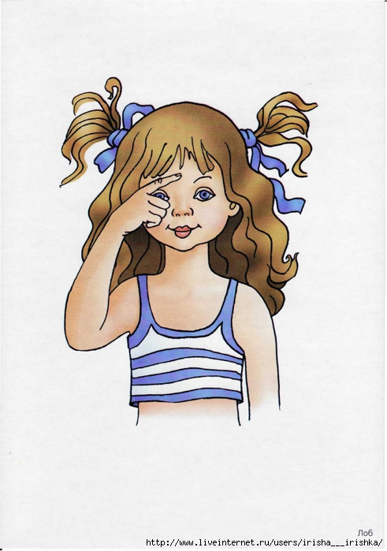

Slide 7
forehead

Slide 8
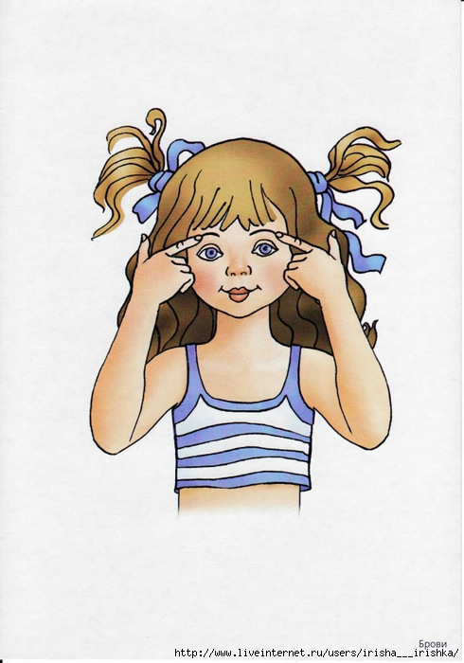

Slide 9
eyebrows

Slide 10
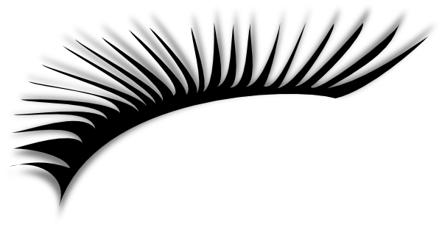

Slide 11
eyelashes

Slide 12
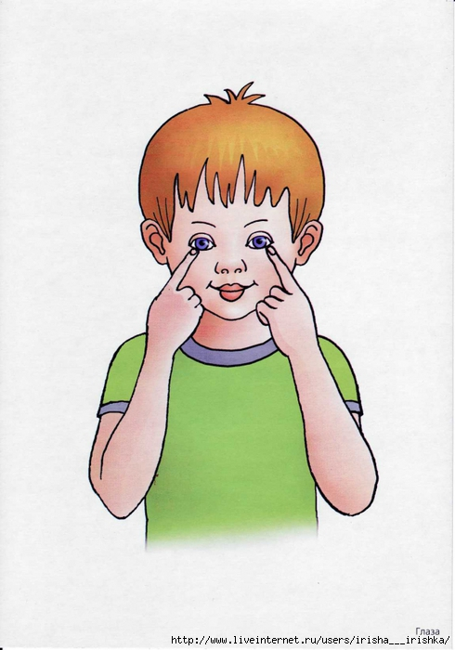

Slide 13
eyes

Slide 14
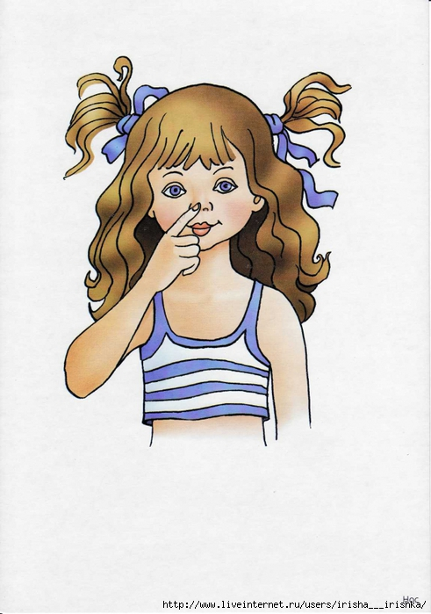

Slide 15
nose

Slide 16
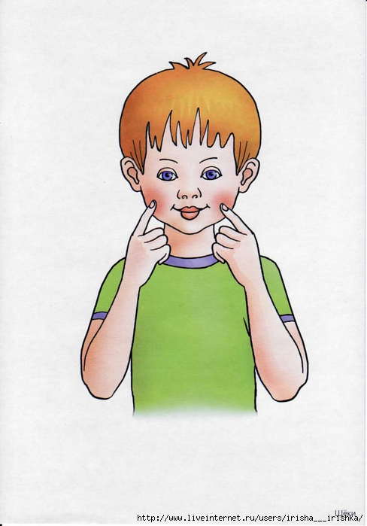

Slide 17
cheek

Slide 18
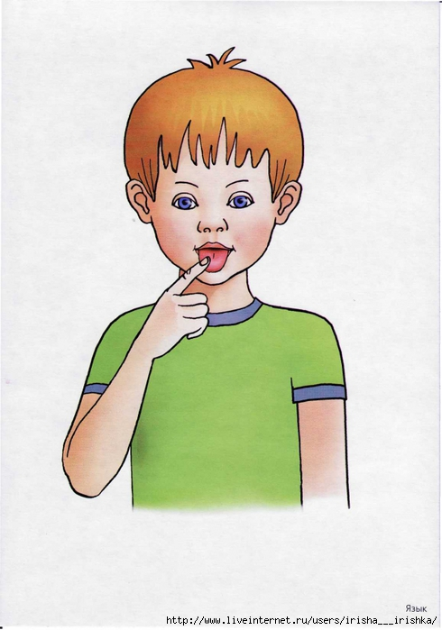

Slide 19
tongue

Slide 20
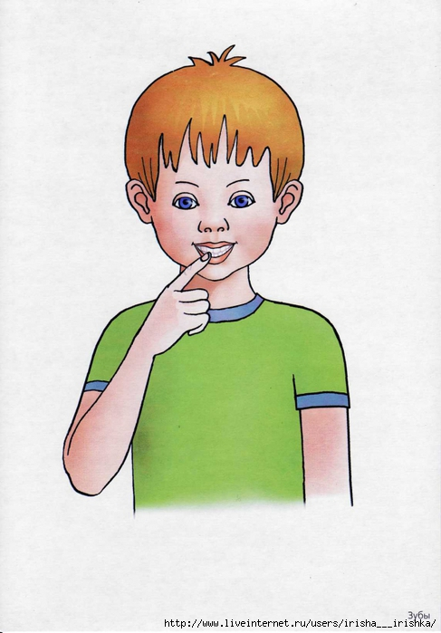

Slide 21
teeth

Slide 22
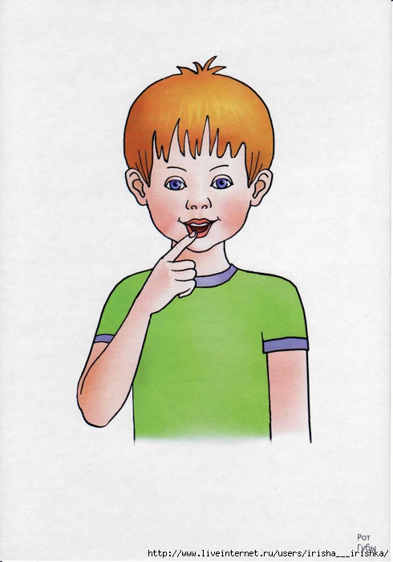

Slide 23
lips mouth

Slide 24
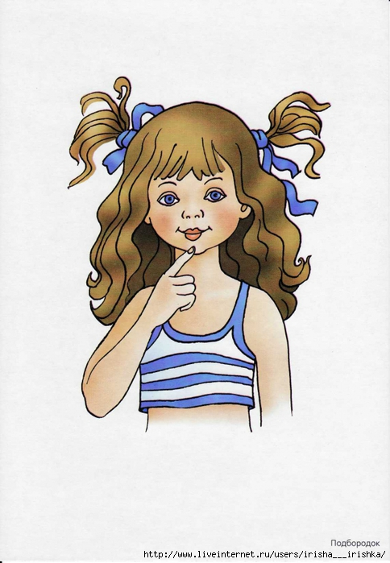

Slide 25
chin

Slide 26
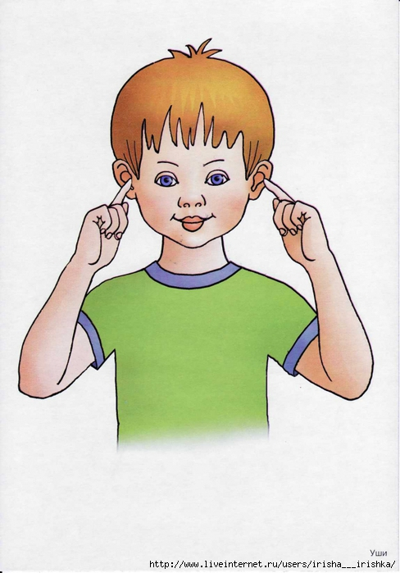

Slide 27
ears

Slide 28
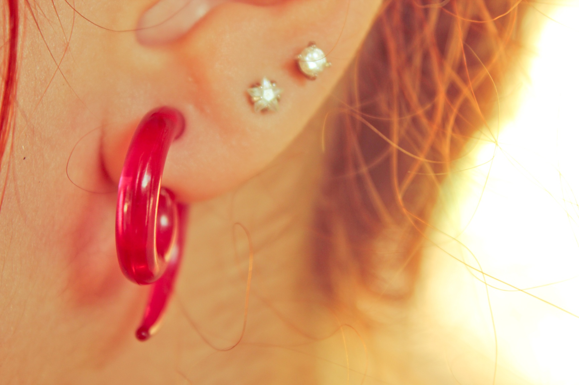

Slide 29
lobe

Slide 30


Slide 31
hair

Slide 32
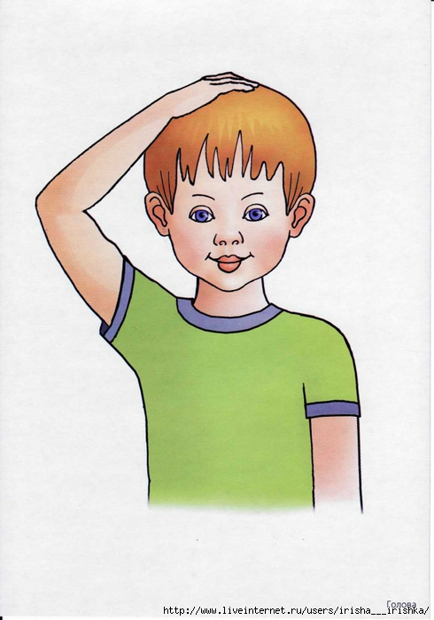

Slide 33
head

Slide 34
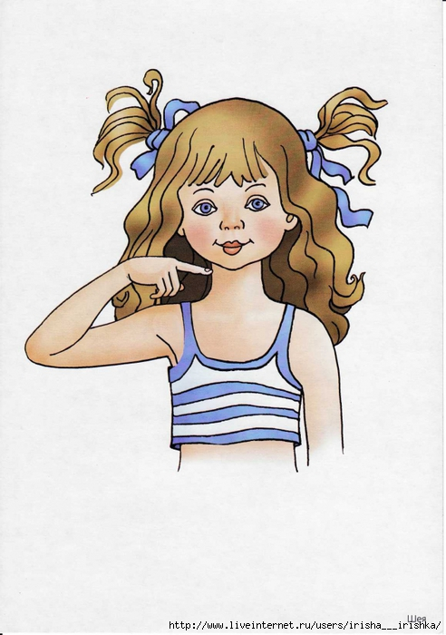

Slide 35
neck

Slide 36
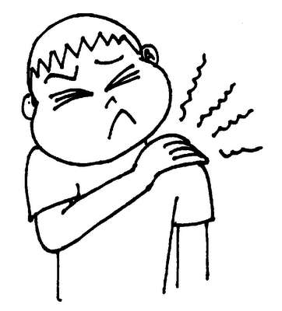

Slide 37
shoulder

Slide 38
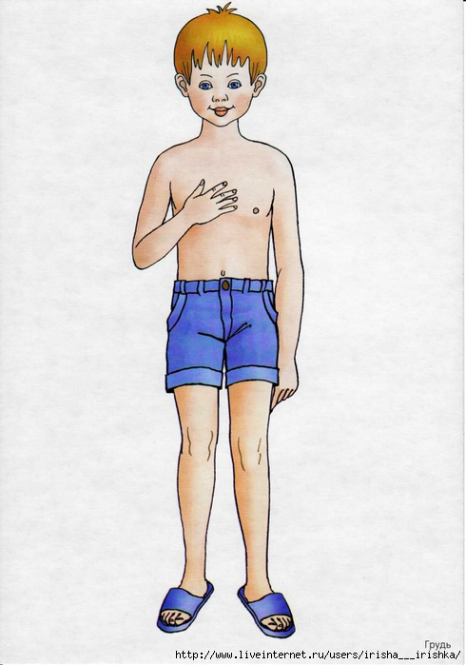

Slide 39
chest

Slide 40
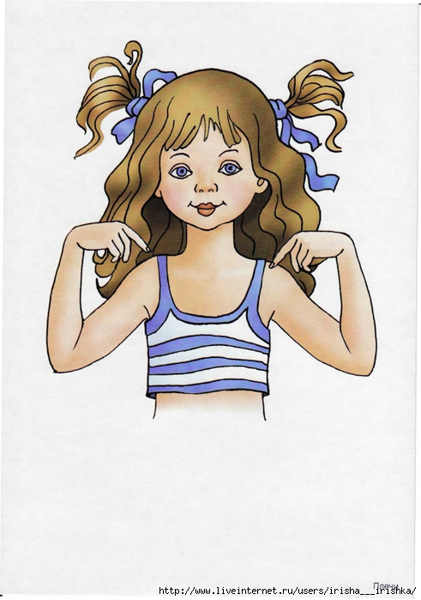

Slide 41
breast

Slide 42
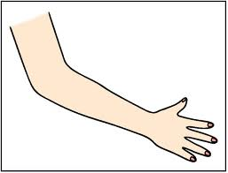

Slide 43
arm

Slide 44
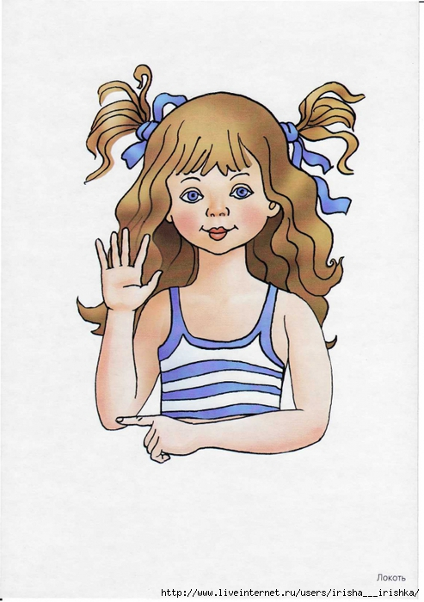

Slide 45
elbow

Slide 46
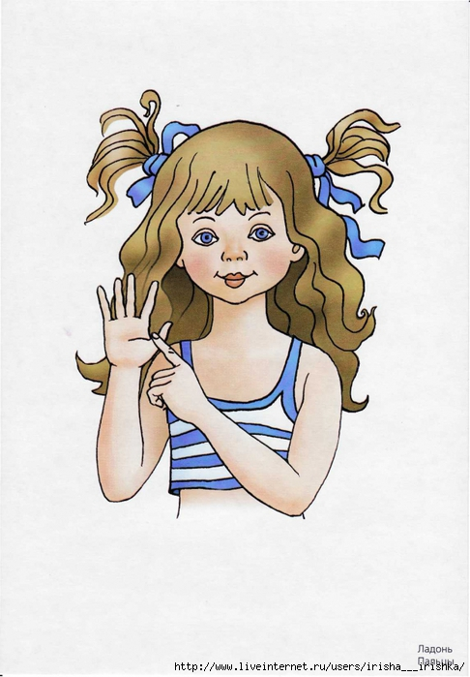

Slide 47
hand

Slide 48
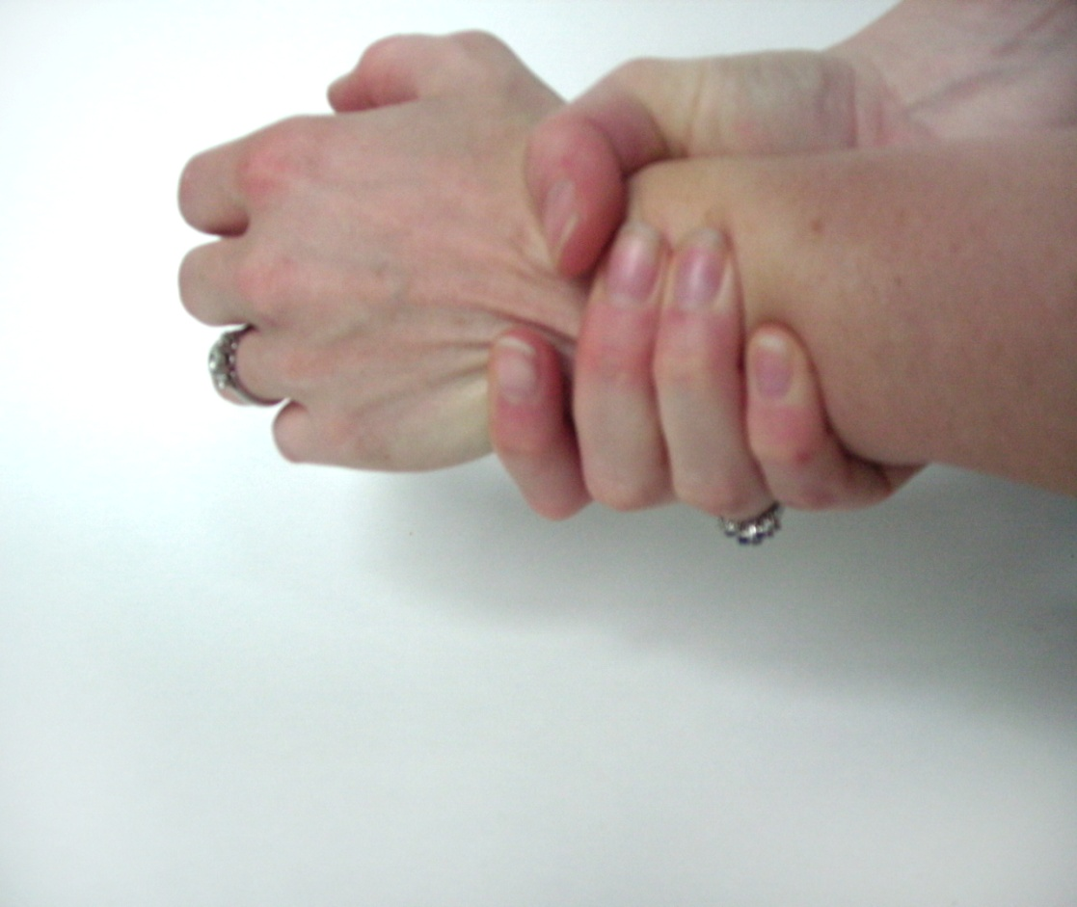

Slide 49

wrist

Slide 50
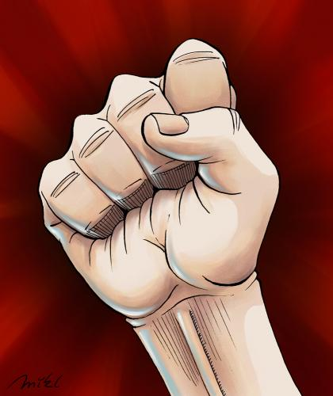

Slide 51
fist

Slide 52
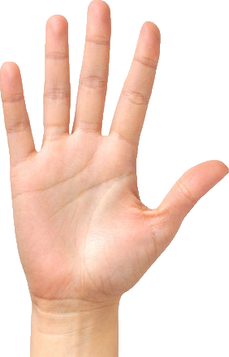

Slide 53
palm

Slide 54


Slide 55
thumb

Slide 56
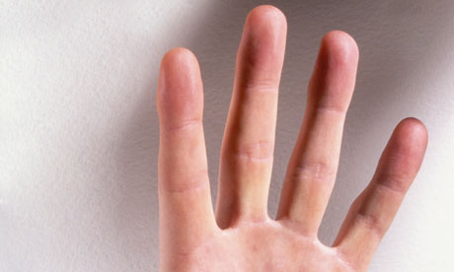

Slide 57
finger

Slide 58
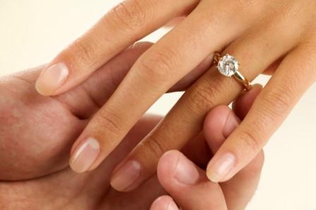

Slide 59
fourth finger ring finger

Slide 60
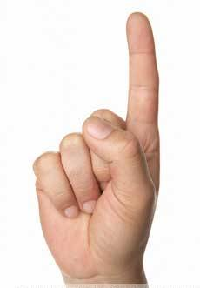

Slide 61
index finger forefinger

Slide 62
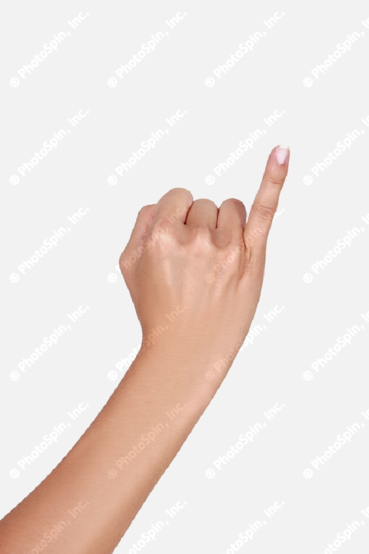

Slide 63
little finger

Slide 64
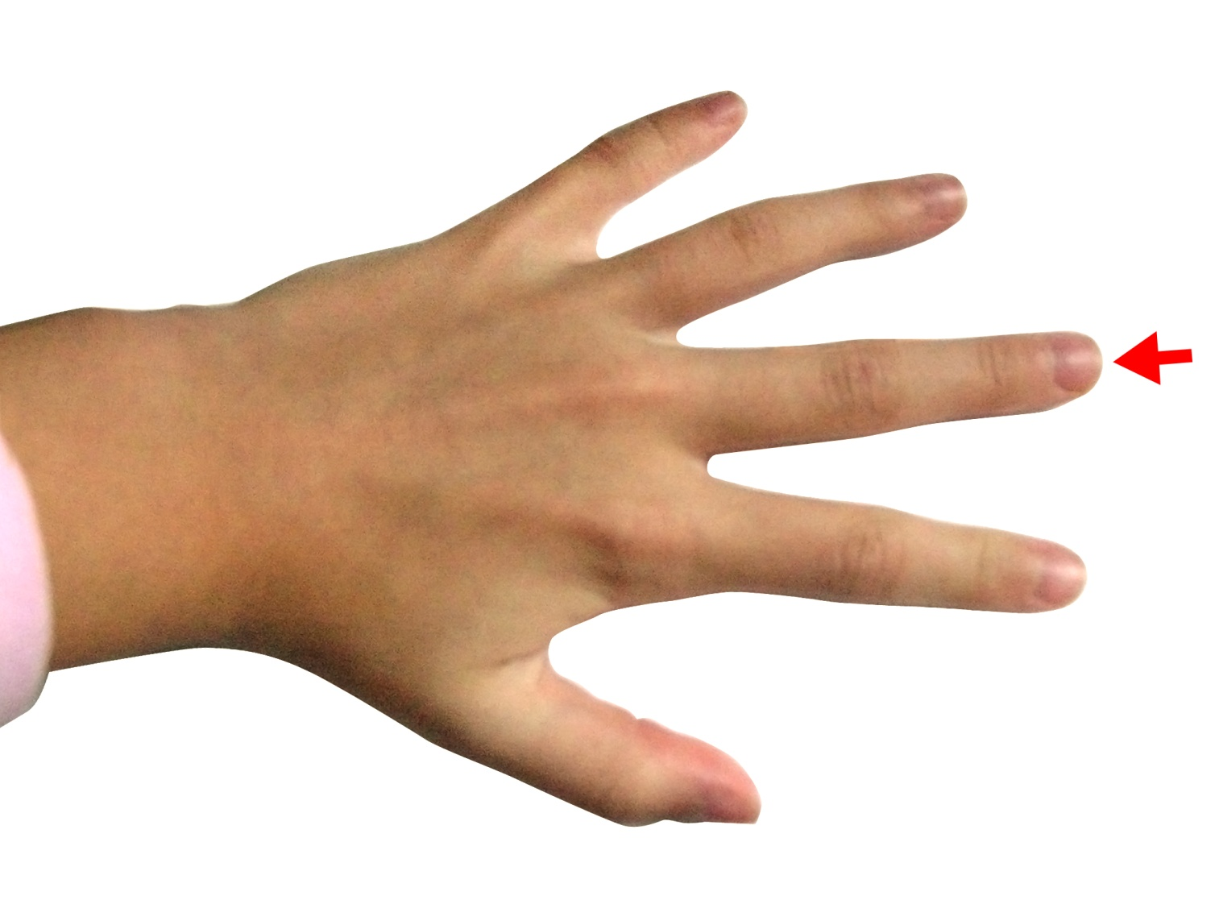

Slide 65
middle / second finger

Slide 66
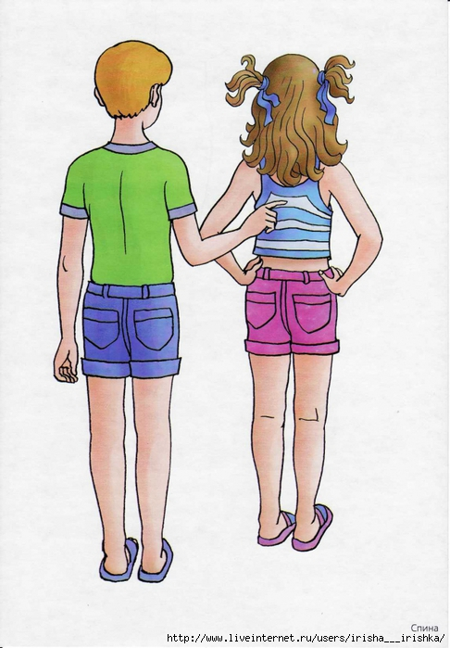

Slide 67
back

Slide 68
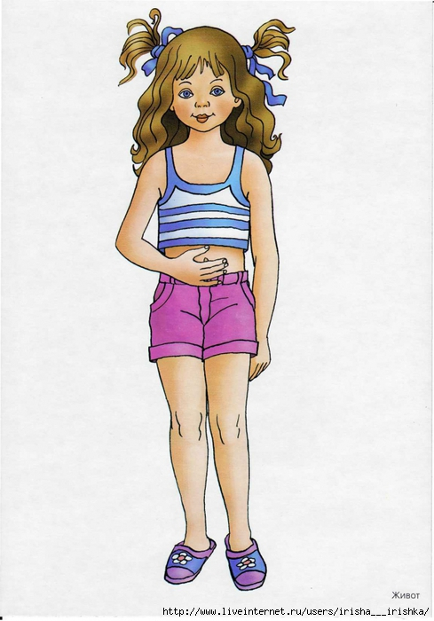

Slide 69
tummy

Slide 70
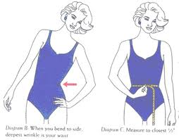

Slide 71
waist

Slide 72
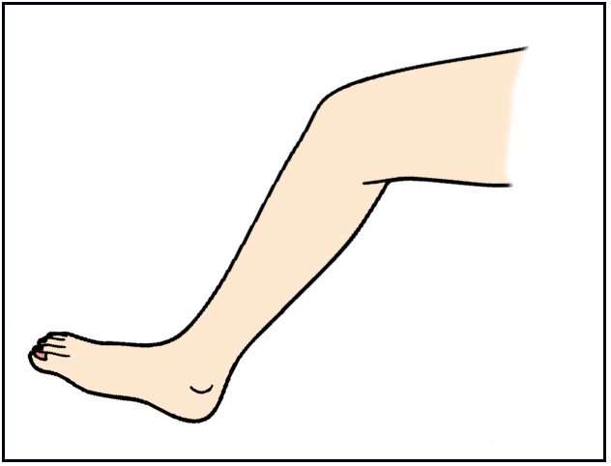

Slide 73
leg

Slide 74
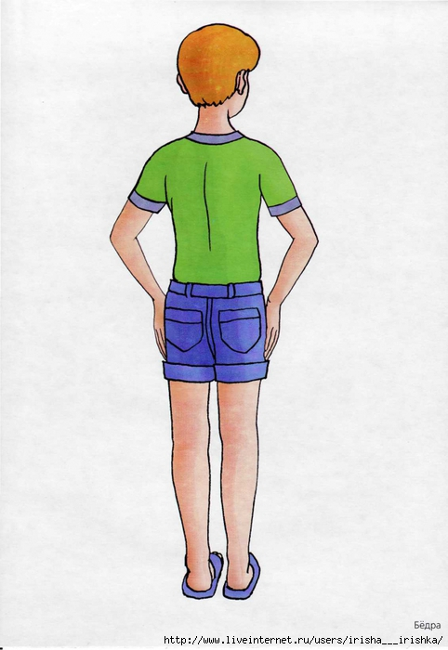

Slide 75
hips

Slide 76
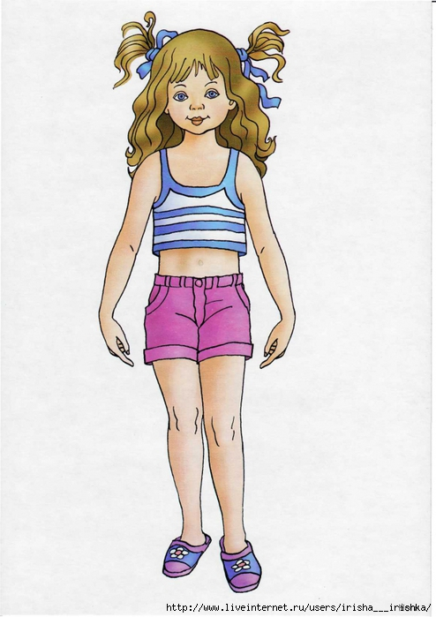

Slide 77
thigh

Slide 78
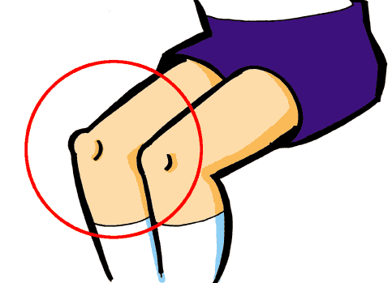

Slide 79
knee

Slide 80
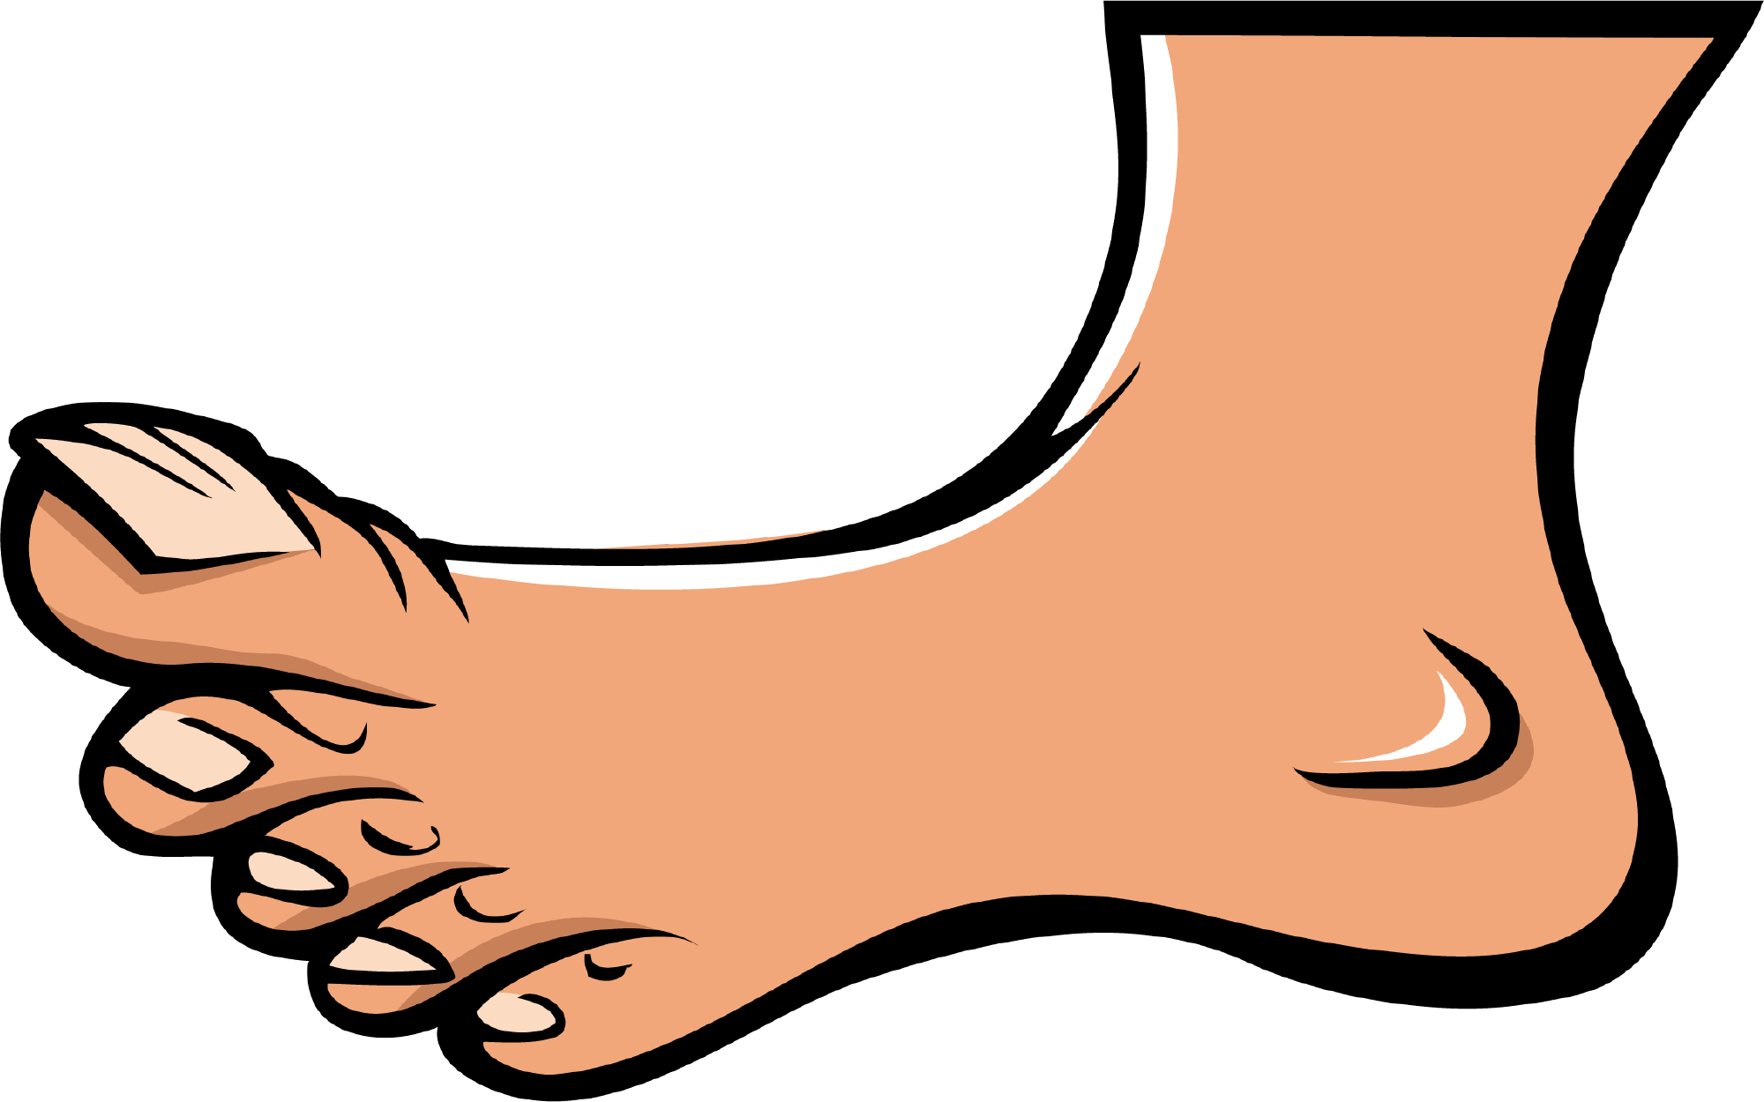

Slide 81
foot

Slide 82
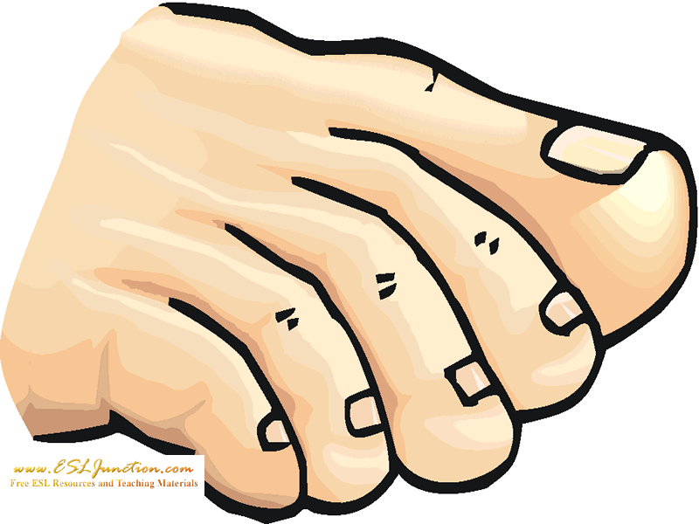

Slide 83
toes

Slide 84
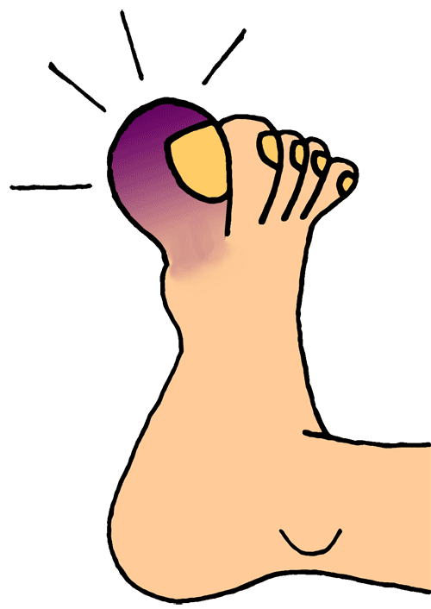

Slide 85
big/ great toe

Slide 86
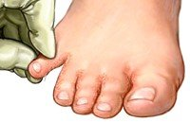

Slide 87
little toe

Slide 88
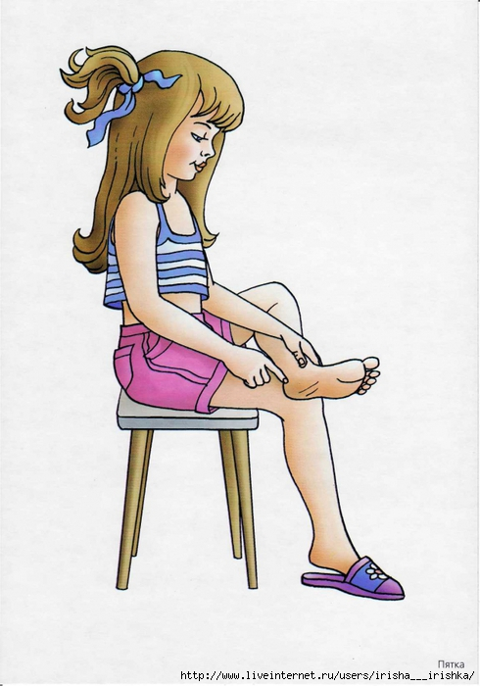

Slide 89
heel

Slide 90
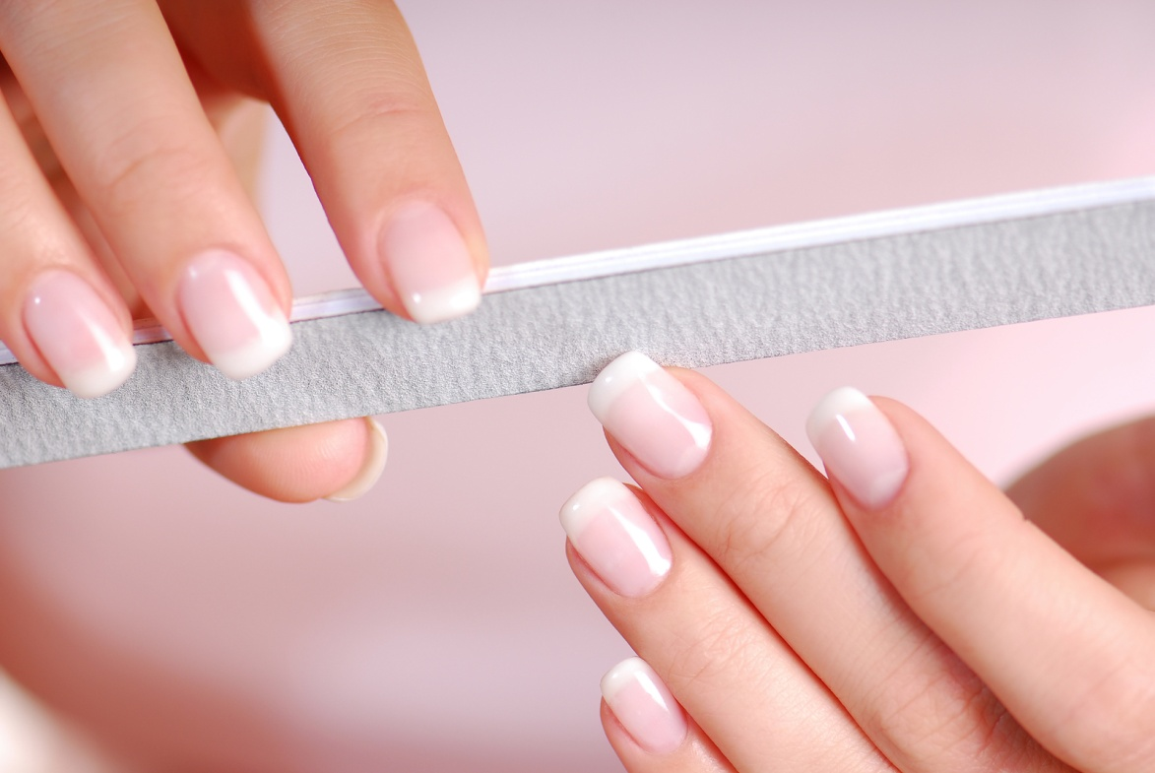

Slide 91
nails

Slide 92
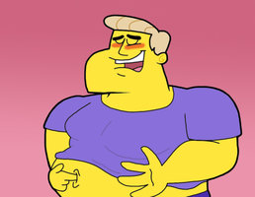

Slide 93
navel belly button

